Slide 1
Project Presentation of Industry Oriented Hands on Experience (22CS422)
On
Spotting AI-Generated Text Content Using Human Writing Patterns
Supervised By
Dr. Swati Goel
Assistant Professor, Dept. of Computer Science & Engg.
Department of Computer Science and Engineering,
Chitkara University, Punjab
Submitted By
Name of Student | Roll Number
Aditya Kaundal | 2211981021
Anshul Katoch | 2211981077
Rudar Partap Singh | 2211981321
Mohit Thakur | 2211981225
1

Slide 2
Introduction
• AI tools can now write text that looks very close to human writing.
• Because of this, it becomes difficult to know whether a text was written by a person or generated by AI.
• Our project detects text as Human Written or AI Generated.
• The system uses simple writing patterns and machine learning to make the prediction.
• The final model is also shown through a Flask web application.
2

Slide 3
Problem Statement and Objectives
• Problem: AI-generated text is becoming common in assignments, articles and online content.
• Objective 1: Prepare a clean machine learning pipeline for text detection.
• Objective 2: Test five models on the same dataset for fair comparison.
• Objective 3: Select the best model based on accuracy, speed and model size.
• Objective 4: Deploy the selected model in a simple web application.
3

Slide 4
Team Details
S. No. | Student Name | Roll Number
1 | Aditya Kaundal | 2211981021
2 | Anshul Katoch | 2211981077
3 | Rudar Partap Singh | 2211981321
4 | Mohit Thakur | 2211981225
Project Mentor: Dr. Swati Goel, Assistant Professor, Department of Computer Science and Engineering
4

Slide 5
Dataset and Preprocessing
• Dataset was taken from Kaggle.
• Total samples were around 400,000.
• Almost half texts were human-written and half were AI-generated.
• Only text content was used for prediction.
• Text was converted to lowercase.
• Special characters and extra spaces were removed.
• TF-IDF was used to convert text into numerical features.
• Unigrams and bigrams were used to capture word and phrase patterns.
5

Slide 6
Methodology
Flow of working of the AI Text Detector
Text Data
Preprocessing
TF-IDF Features
Train 5 Models
Compare Results
Flask Web App
→
→
→
→
→
First, text data is collected from the dataset.
Then the text is cleaned and converted into TF-IDF features.
After that, five machine learning models are trained and compared.
Finally, the best model is used in the Flask website for real-time prediction.
6

Slide 7
Models Tested
Model | Easy Explanation
Naive Bayes | Basic and very fast text classification model
Decision Tree | Makes decisions using if-else type rules
Random Forest | Uses many decision trees together
SVM (Linear) | Works well with large text feature spaces
Logistic Regression | Simple, accurate, fast and easy to deploy
7

Slide 8
Performance Comparison
Model | Accuracy | Precision | Recall | F1-Score
Naive Bayes | 91.24% | 90.8% | 91.6% | 91.2%
Decision Tree | 93.67% | 93.1% | 94.2% | 93.6%
Random Forest | 96.41% | 96.0% | 96.8% | 96.4%
SVM (Linear) | 97.83% | 97.5% | 98.1% | 97.8%
Logistic Regression | 98.88% | 98.7% | 99.0% | 98.8%
Logistic Regression performed best with 98.88% accuracy, so it was selected for deployment.
8

Slide 9
Why Logistic Regression Was Selected
• It gave the highest accuracy: 98.88%.
• It is lightweight and has a small model size of 1.9 MB.
• It gives prediction very fast, around 2 ms inference latency.
• It directly provides confidence/probability score.
• It is easier to explain than complex deep learning models.
9

Slide 10
Operational Efficiency
Model | Training Time | Latency | Model Size
Naive Bayes | 3.2 s | < 1 ms | 0.8 MB
Decision Tree | 18.7 s | 2 ms | 14.3 MB
Random Forest | 312.4 s | 47 ms | 218.6 MB
SVM (Linear) | 87.3 s | 3 ms | 2.1 MB
Logistic Regression | 24.6 s | 2 ms | 1.9 MB
• Random Forest was accurate but heavy and slow compared to Logistic Regression.
• Logistic Regression is best for a simple local Flask web application.
10

Slide 11
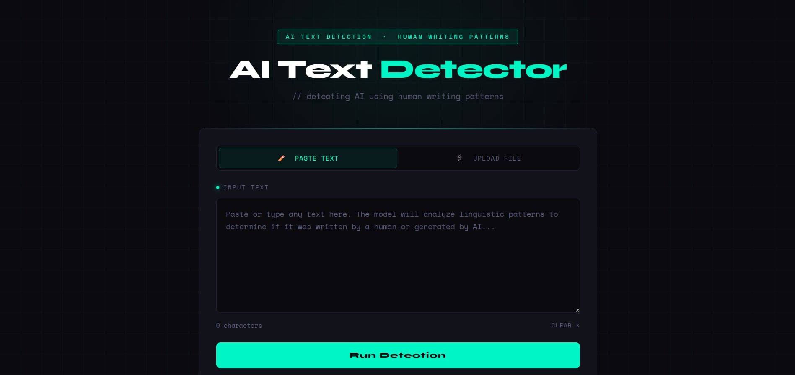
Website Snapshot: Main Interface
Main interface where user can paste text and run detection
11

Slide 12
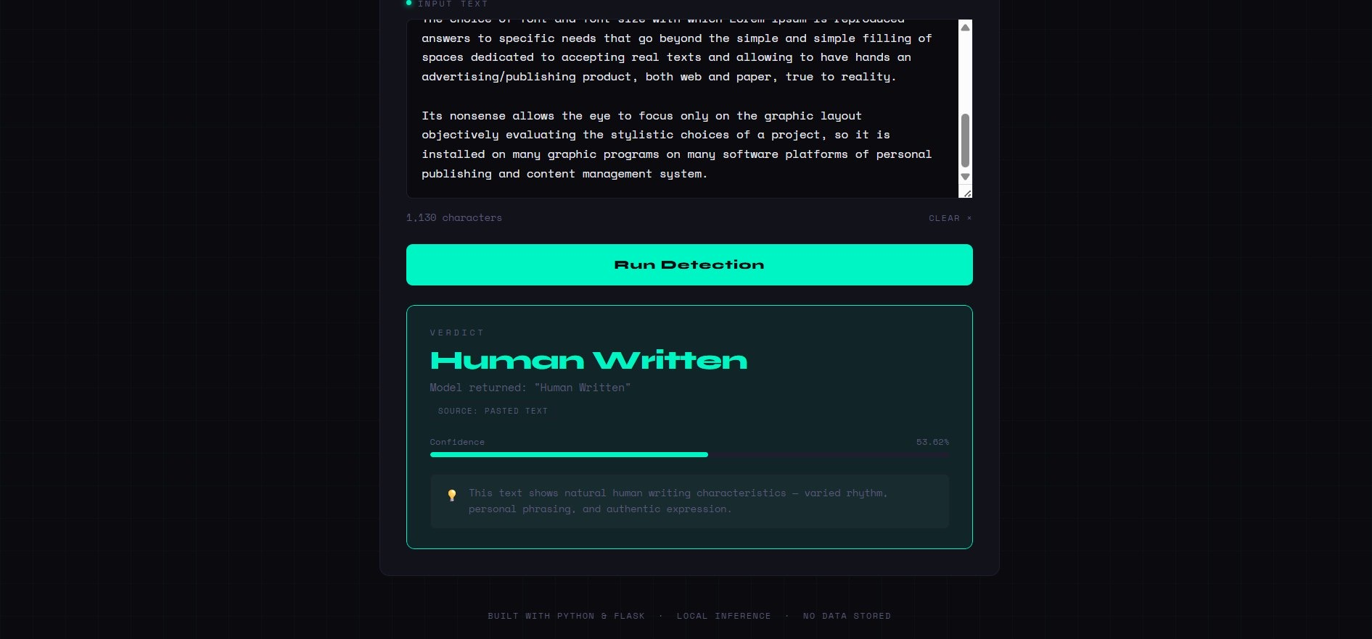
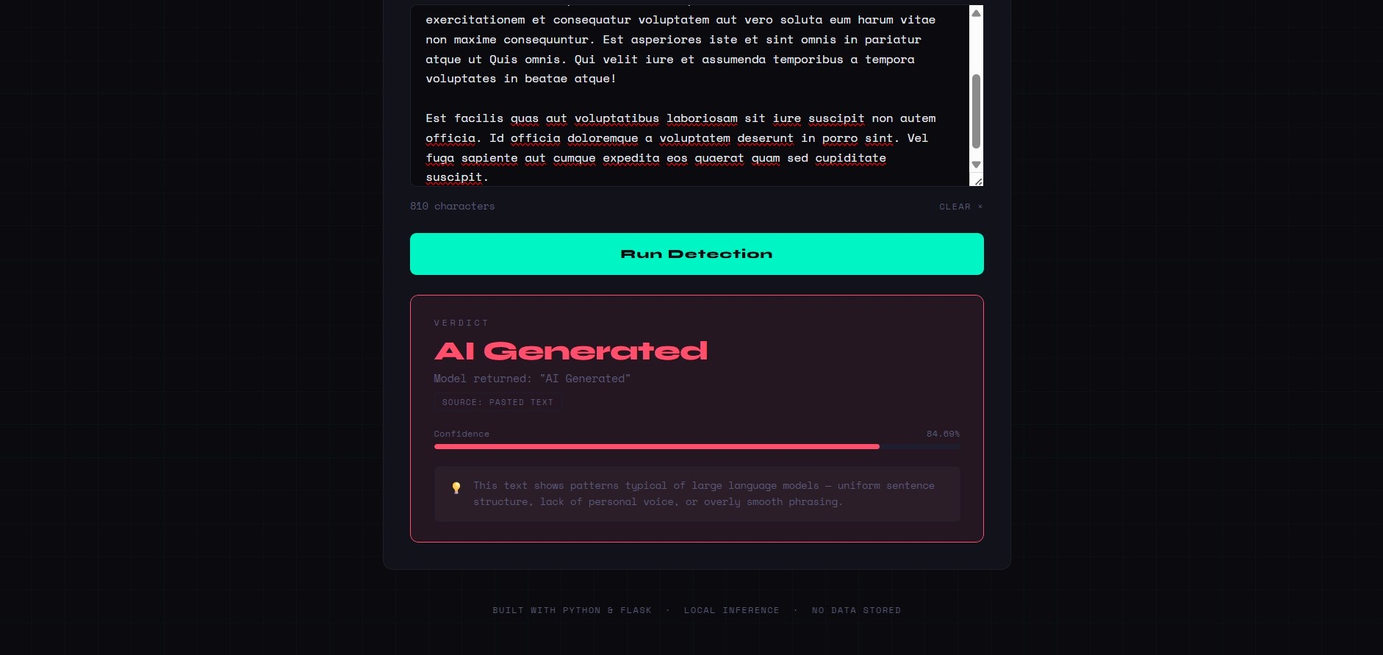
Website Snapshot: Pasted Text Results
Human Written result with confidence score
AI Generated result with confidence score
12

Slide 13
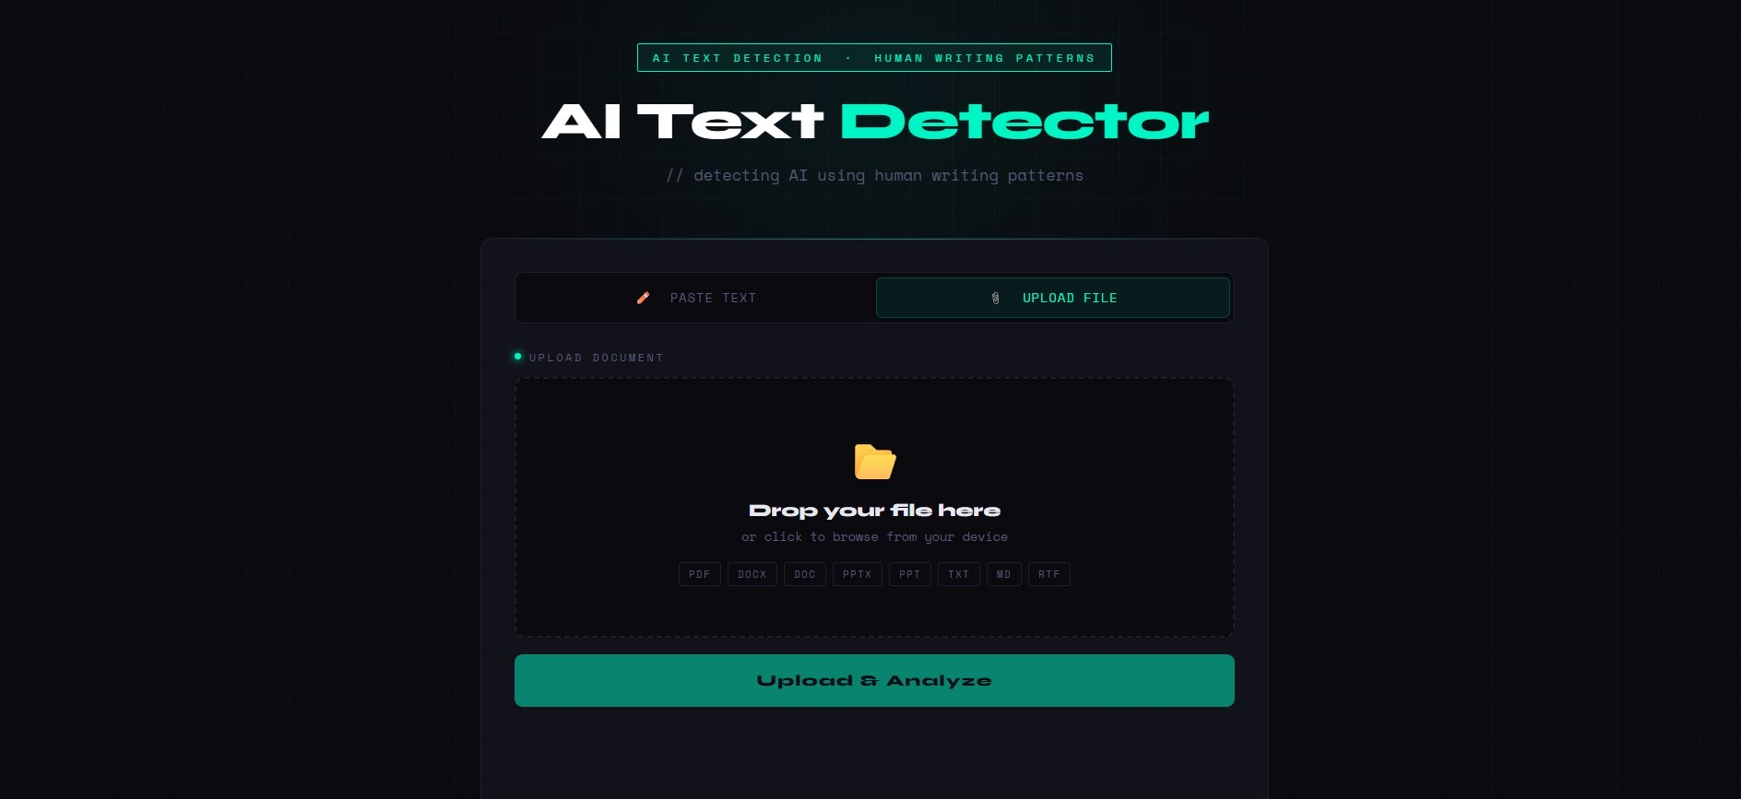
Website Snapshot: Upload File Option
Upload section supports PDF, DOCX, DOC, PPTX, PPT, TXT, MD and RTF files
13

Slide 14
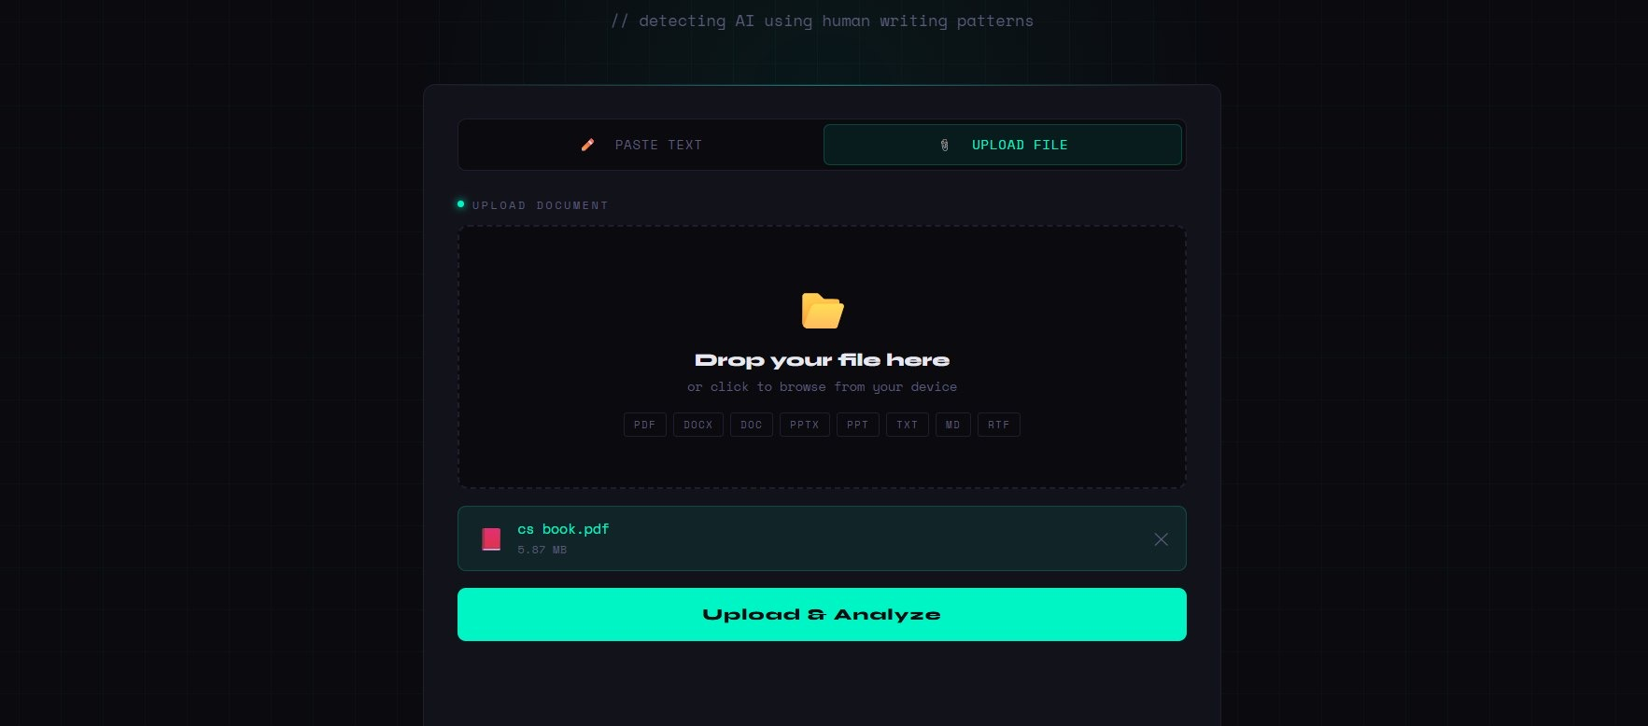
Website Snapshot: File Selected
Uploaded file example: cs book.pdf
14

Slide 15
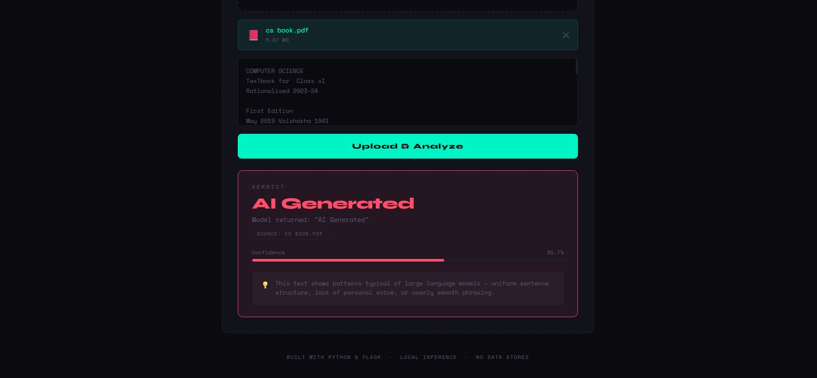
Website Snapshot: Uploaded File Result
The uploaded PDF is analyzed and a final verdict is shown
15

Slide 16
Conclusion and Future Scope
• This project detects whether text is Human Written or AI Generated.
• Five machine learning models were compared on the same dataset.
• Logistic Regression gave the best result and was deployed in a Flask web application.
• The system can check pasted text and uploaded documents.
• Future improvement can include newer AI data, sentence-level features and transformer models.
16

Slide 17
Thank You
17

